Slide 1

Introduction
On-premises
AWS Transition
Cloud
Before
Windows Web Servers
Two CPUs (4-GB memory)
Microsoft Windows
Proxy load balancer
Microsoft SQL DB
32-GB memory
5-TB storage
SQL Server Standard Edition
After
AWS EC2
Two T3 Medium (4-GB memory)
Microsoft Windows
Elastic Load Balancer
AWS RDS with Microsoft SQL Server
Db.t3.2xlarge (32-GB memory)
On-demand scalable storage
Includes SQL Server License

Slide 2
Executive Summary
Goals
Transition web applications to AWS
Transition DB servers to AWS
Configure networks
Configure security and permissions
Manage and audit services
How we did it:
Research AWS Services
Search for corresponding cloud solutions
Design and validate overall architecture

Slide 3
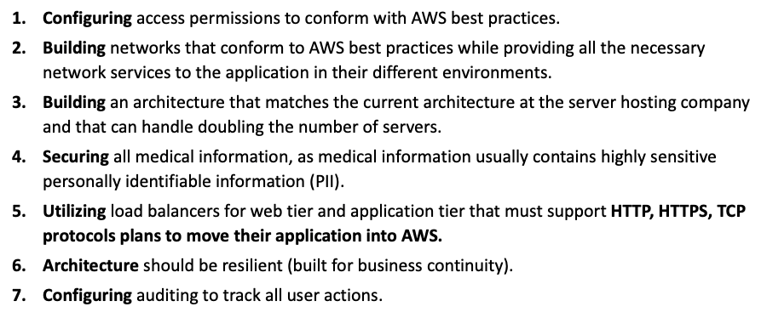
Requirements
The requirements include:
– User authentication
– Web and Application Tier
– Network and Security
– Business Continuity
– Monitoring + Auditing

Slide 4
Assumptions
Assume the medical company wants a DNS resolver -> Route 53
Assume the medical company has clients primarily on east coast but encompassing multiple regions
Assume they have enough customers to warrant a solid long term cloud setup
Assume our solution is compliant with local/relevant privacy laws
A /16 CIDR range was adopted assuming that the company will expand drastically and require more resources in the near future

Slide 5
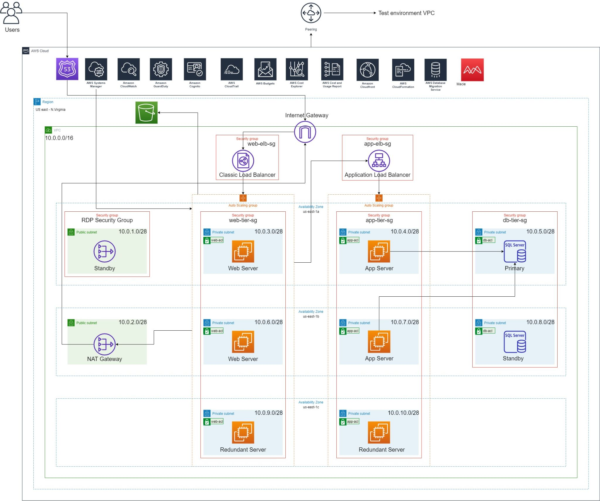
Architecture

Slide 6
Network
A VPC in the N. Virginia region is chosen for the production environment with an IP address range - 10.0.0.0/16
All servers are deployed in private subnets with a subnet mask of /28
The VPC consists of an Internet Gateway to route traffic to and from the VPC
A NAT Gateway is deployed in one of the public subnets to enable servers within the private subnet to connect to the internet
Route53 service is deployed to resolve the IP address of the company from its domain name
Classic load balancer and Application load balancer is used for load sharing and also sending traffic to the respective servers

Slide 7
Security
Elastic load balancers and web tier instances are under a security group that only allow HTTP/HTTPS access (Ports: 80 and 443)
Database server instance is under the security group that only allows TCP connection to the MS SQL server (Port: 1433) from the application servers
Session Manager and Systems Manager are used to connect to the EC2 server instances
As an additional layer of security, Network ACLs have been implemented for the subnet groups
Private subnets connected to NAT gateway will help prevent anonymous HTTP connections to the server instances and DDOS attacks
Amazon GuardDuty has been deployed for continuously monitoring malicious and unauthorized behaviour
AWS Macie is used to analyze, identify and protect sensitive data

Slide 8
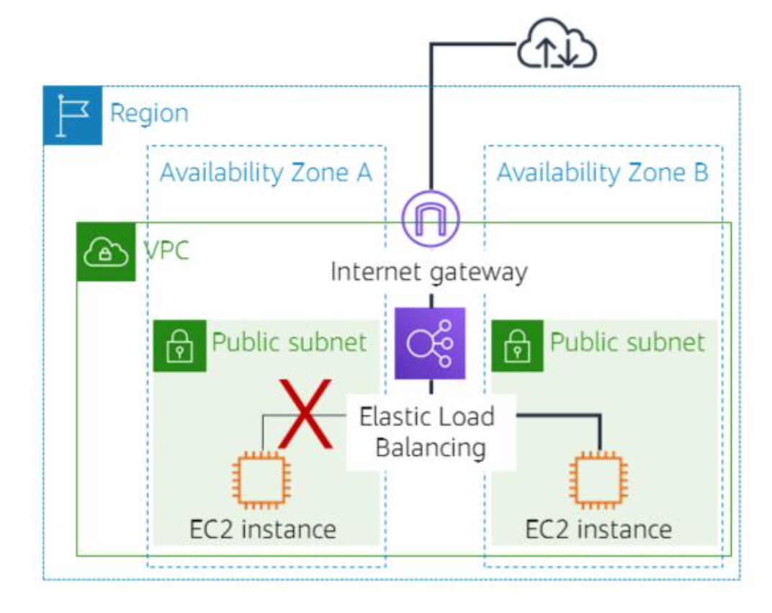
Scalability, High Availability, and Business Continuity
Scalability
Amazon EC2 Auto Scaling
Implement your own scaling policies
Dynamic scaling - Target tracking scaling
Evenly distributes load
HA/Business Continuity
Elastic Load Balancer
What happens if a server is unavailable?
Website remains operational
Multiple availability zones
Minimizes chance of failure

Slide 9
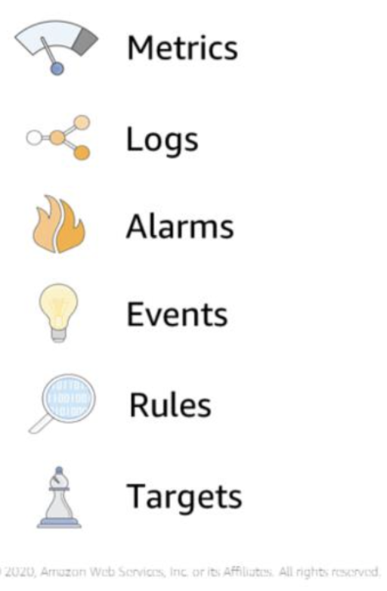
Monitoring and Auditing
Monitoring infrastructure resources:
AWS Cost Explorer, AWS Budgets, AWS Cost and Usage Report, and the Cost Optimization Monitor:
monitor the cost of AWS infrastructure (EC2, S3, RDS)
CloudWatch:
continuously monitor AWS resources, applications, and services that run in AWS and on-premises
GuardDuty:
threat detection and continuous monitoring
protect AWS accounts, workloads, and data
Auditing to track all user actions
CloudTrail:
track user activity and API usage for security purpose
ensure that logs are stored in a secure location

Slide 10
Next Steps and Conclusions
What comes next?
Determine auto-scaling mechanism: Is traffic consistent (predictive) or uneven (dynamic)?
Employees must undergo AWS training as per their IAM roles
Assuming the company continues growing, how can they expand internationally?
What we learned:
How to examine an existing architecture and determine suitable AWS equivalents
Learned how various AWS components integrate and interact with one another
Translate customer requirements into a proposed technical solution

